Slide 1

Big Data and Hadoop Lesson 1: Introduction to Hadoop

Slide 2
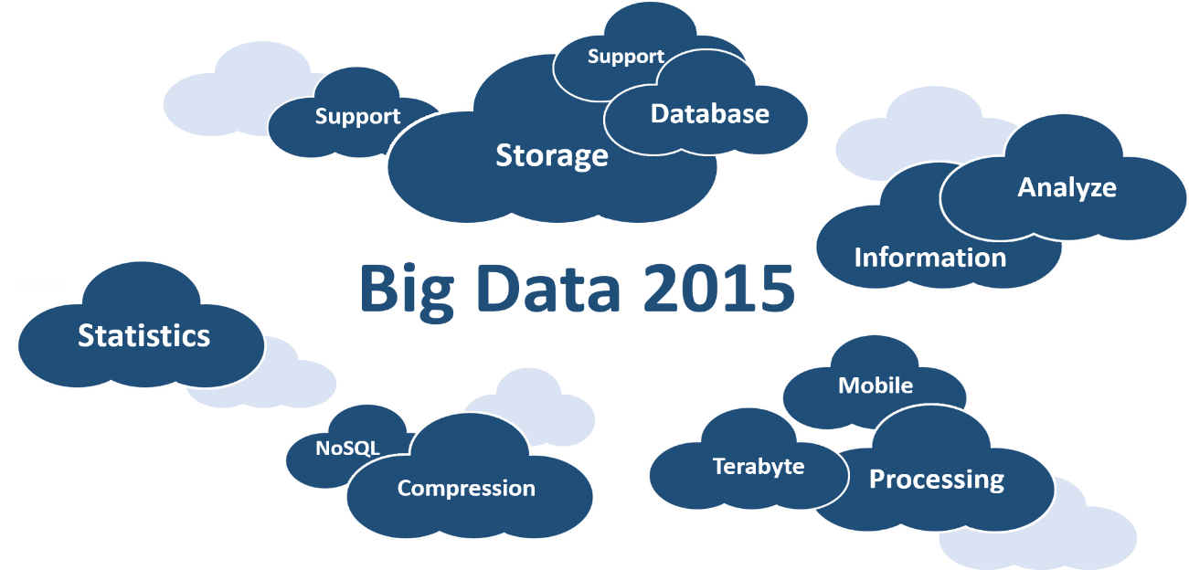
What is Big Data
Big Data refers to data-sets so large & complex that it becomes difficult to manage & process via traditional RDBMS tools
Every day we roughly create 2.5 Quintillion bytes of data; 90% of the worlds collected data has been generated only in the last 2 years
Data sizes are now in Peta-bytes, Tera-bytes, Exa-bytes & Zeta-bytes
Notes:
Do you guys know what a Tsunami is? Well, that is how BIG Data hit the technology world over the last 8 years. Only in the last 2 years, we’ve generated 90% of the worlds available data and this is just the beginning.
It is not a technology. It is not a tool. BIG Data is extremely large volumes of data, mostly unstructured in nature, which cannot be stored, processed or managed by traditional RDBMS tools. Till date, we’re very familiar with Giga-bytes & Mega-bytes. However, BIG Data runs in Petabytes, Terabytes and beyond.

Slide 3
Metrics of Data Size
Till date, we’ve only been familiar with data in GB. The world in changing now
Data Metrics Hierarchy
1024 BYTES = 1 KB
1024 KILOBYTES = 1 MB
1024 MEGABYTES = 1 GB
1024 GIGABYTES = 1 TB
1024 TERABYTES = 1 PB
1024 PETABYTES = 1 EB
1024 EXABYTES = 1 ZETABYTES
Notes:
Just to give you a comparison; here is a table showcasing the difference between each data-metric. Today, we have data being generated running even into Zeta-bytes. Just to give you a little context, a Zeta-byte is one followed by 21 zeroes.

Slide 4
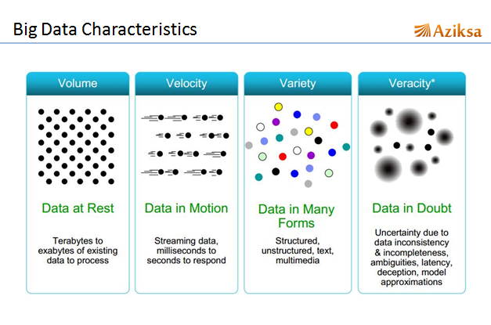
Characteristics of Big Data
Big Data is characterized by 4 V’s: Volume, Velocity, Variety and Veracity
Big Data
Volume
Velocity
Variety
Veracity
Notes:
BIG Data is large, complex and diverse. Those qualities are broken down into the following 4 characteristics.
Volume
Velocity
Variety
Veracity

Slide 5
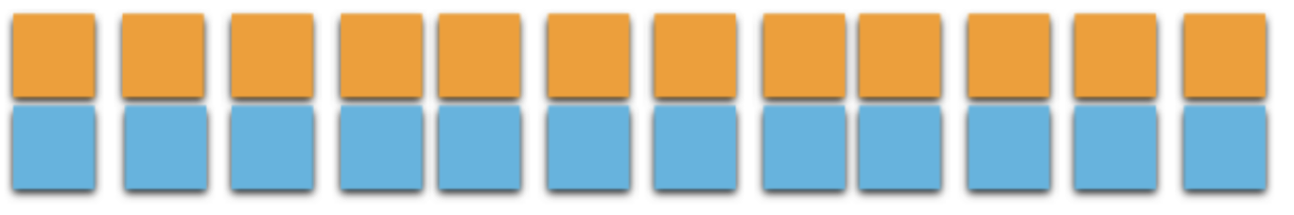
Types of Data – Structured Data
Structured Data
Structured Data is a database with multiple rows & columns with each data-point duly mapped to the relevant row & column
It can be very easily ported into and managed via traditional RDBMS tools
Example: An excel sheet marking the daily office attendance of each employee
Notes:
They are 3 types of Data. Lets start with Structured Data.
This refers to any data-set which can be easily mapped to rows & columns. Due to its structured nature, this type of data can be very easily stored, managed & analyzed by traditional RDBMS tools.
Another example of structured data is a simple calendar; showcasing which date & day are mapped with each other.

Slide 6

Types of Data – Unstructured Data
Unstructured Data
This refers to data which cannot be sorted into traditional rows & columns due to its extremely diverse nature.
It cannot be ported into and managed via traditional RDBMS tools (That’s why we have Hadoop)
Example: Audio Files, Images, Chat logs, Consumer Interactions with Web & Mobile Applications and Email Content.
Notes:
Unstructured data refers to diverse data-sets which cannot be mapped via traditional RDBMS systems. As depicted in the image; unstructured data is very chaotic & unorganized. Examples of unstructured data includes data generated via social media interactions, machine sensors, audio files, images and IOT devices.
Due to the rise & business value of unstructured data; new data-management tools were created such as Hadoop.

Slide 7
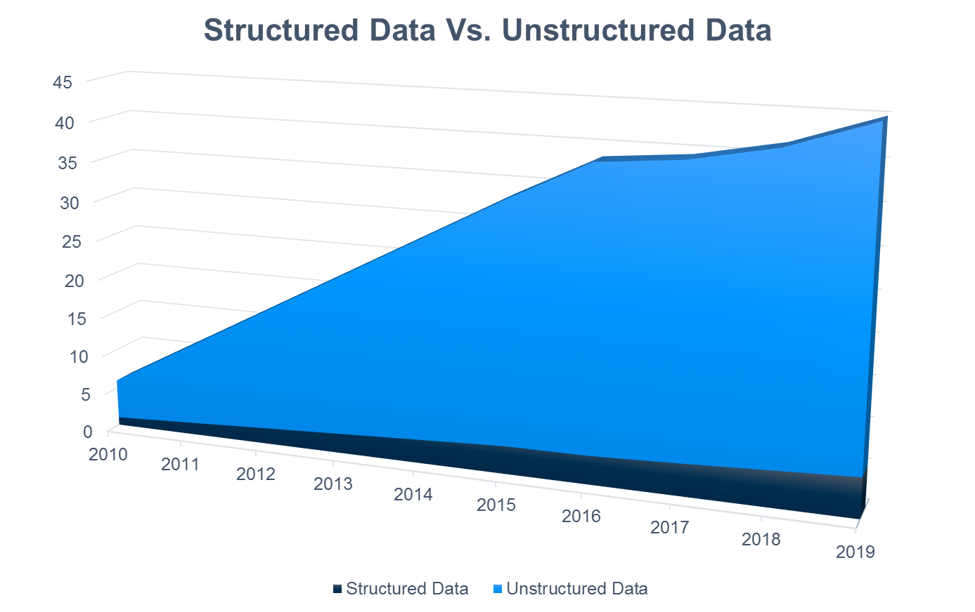
Structured vs Unstructured Data - II
Notes:
This graph depicts the rise of unstructured data from 2010 – 2015, and the forecasted growth from 2016 – 2019. As is very clearly visible, unstructured data will steadily rise over time, whereas structured data will have a minimal influence.

Slide 8


Traditional Systems vs. New Systems
Traditional Systems
New Systems
It is not scalable to meet new business demands
It is scalable to meet new business demands
Cannot scalable process massive + unstructured data
Can easily process massive + unstructured data
It can only be Scaled-Up and cannot be Scaled-Out
It can be Scaled-Up and Scaled-Out
Cost of system, processing and data management is not economical
Cost of system, processing and data management is economical
Notes:
Traditional commonly used systems such as Oracle, DB2 and MySQL have certain limitations because of which they’re unable to handle new business demands.
For example, the social security database of a country or data generated via audio & video files cannot be easily stored, managed and processed by traditional systems due to their inherent flaws in terms of scalability & unstructured data management. They’re designed to Scale-Up; not Scale-Out. This also added an additional drawback in terms of cost. If you have any doubts about this concept; please refer to the earlier lesson.
Due to the rise of unstructured data often in very high volumes, there was a requirement for a new tool to provide a scalable & cost-effective solution. This led to the creation of Hadoop.

Slide 9

Introduction to Hadoop
Hadoop is a framework for storing, processing and analysing Big Data
Allows distributed storage and distributed processing of large data sets across clusters of commodity computers using a simple programming model
It is an Apache Open Source framework
Notes:
Hadoop is a framework which overcame limitations of RDBMS such as storage of large datasets, scalable & distributed processing and inability to handle large and/or unstructured datasets. It is an Apache Open Source framework.
So what exactly is Hadoop? To give it a definition, it is a java based framework utilized for storing, processing and analysing BIG Data. Lets analyse a list of key features which have led to its meteoric rise.

Slide 10
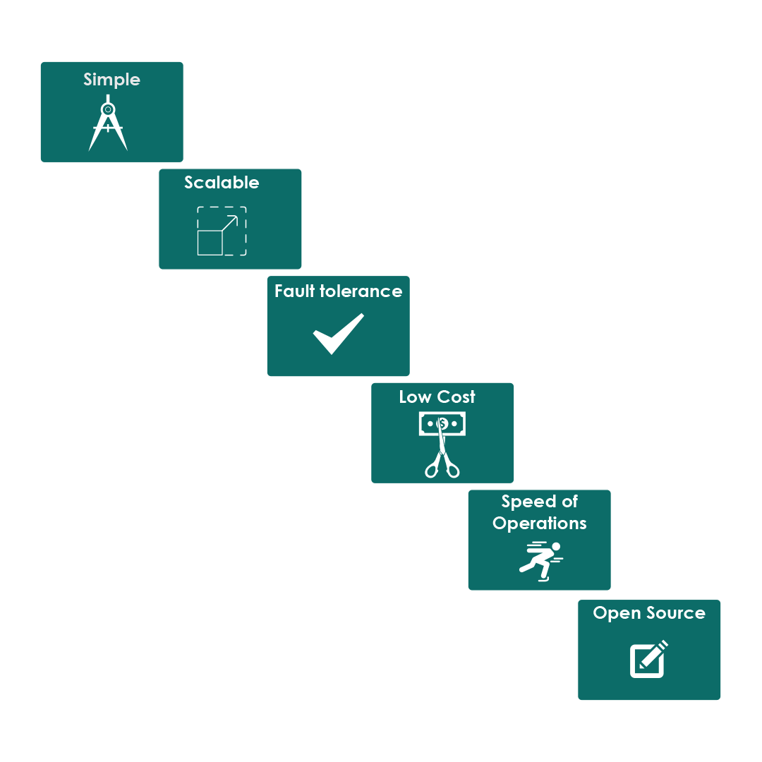
Key Features of Hadoop
It’s based on the Master - Slave architecture
Designed for massive scale
Highly available System
Low software and hardware costs
Distributed storage and processing achieves high performance
No license costs; supported by a very large developer community
Notes:
Hadoop is a very simple framework based on a master-slave architecture. Herein, there is only one command interface which controls all the cluster operations such as read & write of large datasets.
The next feature is scalability. Hadoop is designed in such a way that it can even run thousands of nodes and manage data-sets running into Zeta-bytes. This is a very key differentiator.
And, lets say we have a cluster of 1000 nodes; and a certain section of them happen to fail. The system will still be running & available. Thus, creating very high failure tolerance. Hadoop is a very robust system.
Due to its use of simple commodity hardware & scale-out nature; setting up and managing a Hadoop cluster environment is more cost-effective compare to traditional options.
As Hadoop is based on a distributed architecture powered by parallel processing; it enables very high performance metrics, especially in terms of speed.
Last but not the least, it is open source. This means that they are no license costs involved whatsoever and it has a thriving developer community.
Due to these advantages; companies across the world are adopting Hadoop.

